Slide 1

MINI PROJECT TOPIC:FACIAL RECOGNITION-ENHANCED ATM SIMULATOR FOR WEB PLATFORMS
UNDER THE GUIDANCE OF
MR. HANUMANTH RAO
PRESENTED BY-GROUP 21
B.ASHOK -21P61A0521
D.LIKITH -22P65A0559
D.VIJAY -21P61A0560

Slide 2
CONTENTS
AIM
ABSTRACT
SURVAY
PREVIOUS METHOD OF APPROACH
OUR METHOD OF APPROACH
SOFTWARE TOOLS AND HARDWARE COMPONENTS
APPLICATIONS
CONCLUSION
REFERENCES

Slide 3
AIM
Develop an interactive ATM simulator with integrated face recognition technology on a web platform, designed to provide a realistic user experience for financial transactions. The simulator will enable users to authenticate and perform various banking operations securely and efficiently using facial recognition, demonstrating advanced security and innovative user interface design.

Slide 4
ABSTRACT
This project focuses on creating a web-based ATM simulator that integrates facial recognition technology for user authentication. The simulator is designed to replicate the functionality of traditional ATMs, enabling users to perform various banking tasks—such as checking account balances, transferring funds, and withdrawing cash—through a secure and intuitive interface.
By leveraging advanced face recognition technology, the project aims to enhance security and streamline the user experience, eliminating the need for physical cards or PINs. The simulator will employ modern web development frameworks and face recognition APIs to ensure accurate and efficient authentication processes.

Slide 5
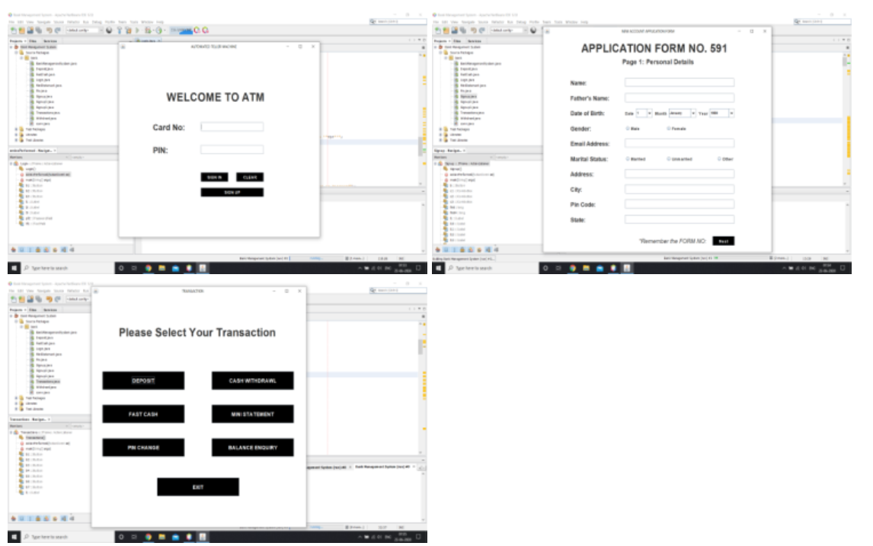
SURVEY

Slide 6
PREVIOUS METHOD
Previous ATM simulator projects have largely been console-based, offering a basic, text-driven interface that lacks visual appeal and interactive features. These early models primarily focus on simulating fundamental banking operations through command-line interfaces, with no provision for graphical user interfaces (GUIs) or advanced security features. As a result, they often miss out on providing a realistic and engaging user experience.
Additionally, these traditional simulators do not incorporate modern security technologies such as facial recognition. User authentication in earlier models is typically handled through basic text input for PINs or account numbers, which does not address contemporary security concerns or provide a seamless user experience.

Slide 7
OUR METHOD OF APPROACH
The project involves creating a web-based ATM simulator with facial recognition for secure user authentication. The development includes designing an intuitive graphical interface using HTML, CSS, and JavaScript, and integrating facial recognition.
On the backend,a structured database stores user profiles and transaction history with strong encryption for data protection. After integration and thorough testing, the application is deployed, monitored, and maintained for performance and security. Comprehensive documentation and user training ensure effective use of the system.

Slide 8
Frontend: Set up a development environment for HTML, CSS, and JavaScript.
Backend: Set up a Java development environment with necessary libraries for web server and facial recognition.
Dependencies
Frontend: Use libraries like face-api.js for facial recognition.
Backend: Use frameworks like Java Servlets for handling server-side logic, and JDBC for database interactions.
Facial Recognition Integration
Integrate a facial recognition library in Java, such as OpenCV or an API service like Microsoft Azure Face API.

Slide 9
TOOLS
MINIMUM HARDWARE REQUIREMENTS
Intel Core i3 or equivalent processor
8 GB RAM
256 GB SSD
720p HD webcam for basic facial recognition testing.
SOFTWARE REQUIREMENTS
Frontend Technologies: HTML, CSS, Javascript
Backend Technologies: Java8, PHP
Frameworks: Java Servlets
Database Management System (DBMS): MySQL

Slide 10
CONCLUSION
The ATM simulator with facial recognition integrates web technologies and biometric authentication to enhance secure financial transactions. Utilizing HTML, CSS, JavaScript, and Java with Spring Boot, the project offers a functional and interactive ATM experience. The inclusion of face-api.js for real-time facial recognition improves security and user convenience.
The project effectively demonstrates the application of modern web and security technologies, providing a robust educational tool and a foundation for future developments in secure financial systems.

Slide 11
REFERENCES
https://github.com/shivamverma26/ATM_Simulator
https://www.geeksforgeeks.org/taking-a-snapshot-from-system-camera-using-opencv-in-java/

Slide 12


